Slide 1
Constructors

Slide 2
Definition
In Java, a constructor is a block of codes similar to the method. It is called when an instance of the class is created. At the time of calling constructor, memory for the object is allocated in the memory.
It is a special type of method which is used to initialize the object.
Every time an object is created using the new() keyword, at least one constructor is called.
It calls a default constructor if there is no constructor available in the class. In such case, Java compiler provides a default constructor by default.
There are two types of constructors in Java: no-arg constructor, and parameterized constructor.

Slide 3
Rules for creating Java constructor
Rules:
Constructor name must be the same as its class name
A Constructor must have no explicit return type
A Java constructor cannot be abstract, static, final, and synchronized

Slide 4
Types of Java constructors
There are two types of constructors in Java:
Default constructor (no-arg constructor)
Parameterized constructor
Java Default Constructor
A constructor is called "Default Constructor" when it doesn't have any parameter.
Syntax of default constructor:
<class_name>(){}

Slide 5
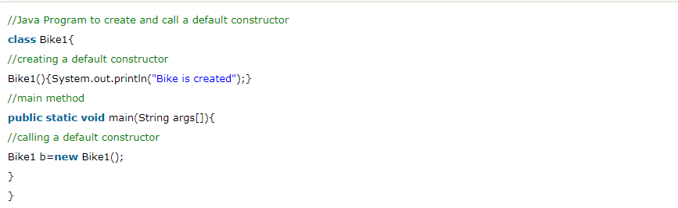
Example of default constructor

Slide 6
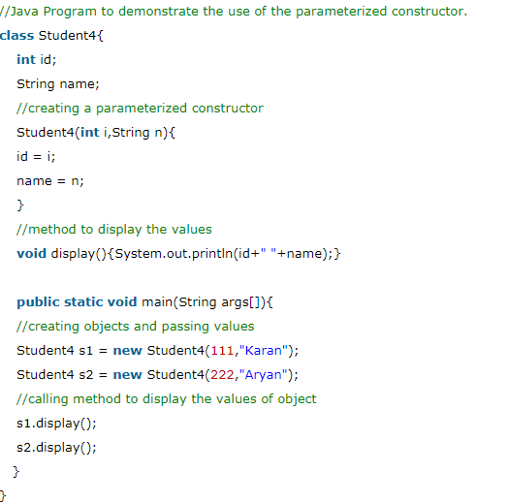
Java Parameterized Constructor

Slide 7
Constructor Overloading in Java
In Java, a constructor is just like a method but without return type. It can also be overloaded like Java methods.
Constructor overloading in Java is a technique of having more than one constructor with different parameter lists. They are arranged in a way that each constructor performs a different task. They are differentiated by the compiler by the number of parameters in the list and their types.

Slide 8
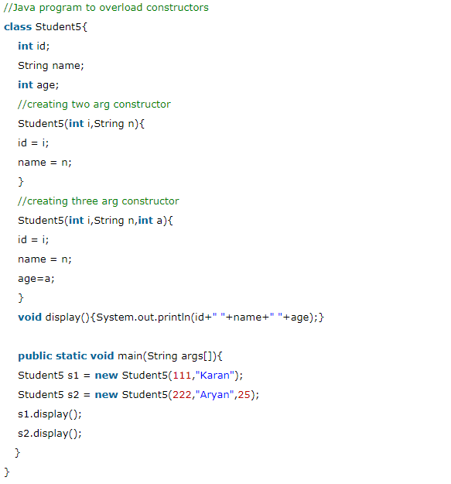

Slide 9
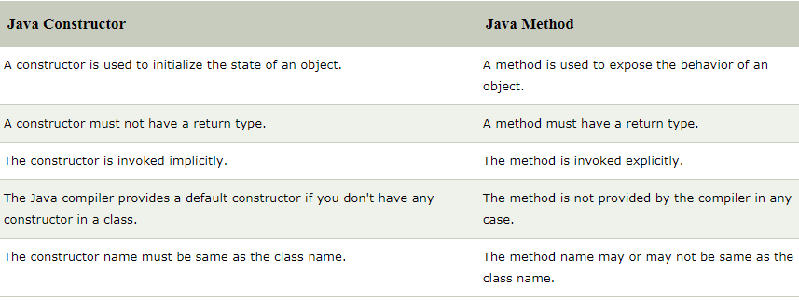
Difference between constructor and method in Java

Slide 10
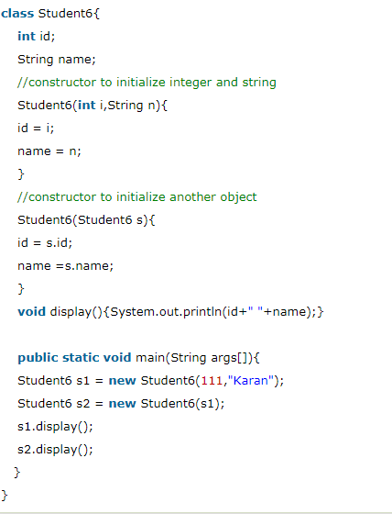
Copy constructor
There is no copy constructor in Java. However, we can copy the values from one object to another like copy constructor in C++.

Slide 11
Questions
Does constructor return any value?
Can constructor perform other tasks instead of initialization?
Is there Constructor class in Java?
What is the purpose of Constructor class?

Slide 12
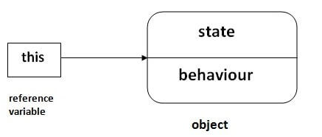
this keyword
There can be a lot of usage of java this keyword. In java, this is a reference variable that refers to the current object.

Slide 13
Usage of java this keyword
this can be used to refer current class instance variable.
this can be used to invoke current class method (implicitly)
this() can be used to invoke current class constructor.
this can be passed as an argument in the method call.
this can be passed as argument in the constructor call.
this can be used to return the current class instance from the method.

Slide 14
1) this: to refer current class instance variable
The this keyword can be used to refer current class instance variable. If there is ambiguity between the instance variables and parameters, this keyword resolves the problem of ambiguity.

Slide 15
2) this: to invoke current class method
You may invoke the method of the current class by using the this keyword. If you don't use the this keyword, compiler automatically adds this keyword while invoking the method. Let's see the example

Slide 16
3) this() : to invoke current class constructor
The this() constructor call can be used to invoke the current class constructor. It is used to reuse the constructor. In other words, it is used for constructor chaining.
Rule: Call to this() must be the first statement in constructor.

